Slide 2
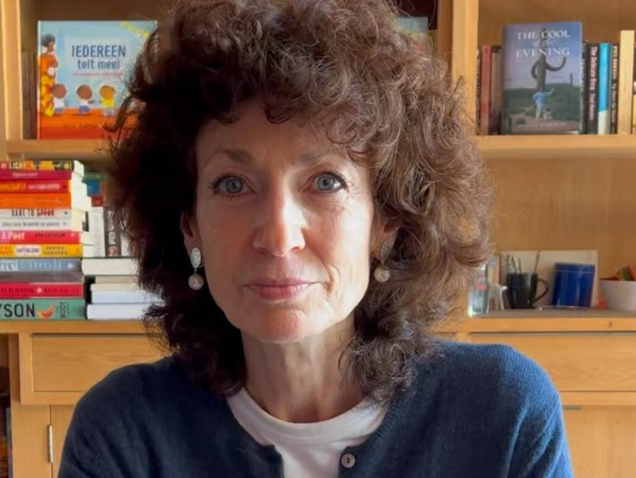
What is Refugee Week?
Refugee Week is a UK-wide festival celebrating the contributions, creativity and resilience of refugees and people seeking sanctuary.
Founded in 1998 and held every year around World Refugee Day on the 20 June, Refugee Week is also a growing global movement.
Through a programme of arts, cultural, sports and educational events, it enables people from different backgrounds to connect and encourages understanding about why people are displaced, and the challenges they face when seeking safety.
Helps people who have sought safety in the UK to share their experiences, perspectives and creative work on their own terms.
Click to watch Hollis Kurman talk about her wonderful book, Hello! A Counting Book of Kindnesses (8 minute video)

Slide 3
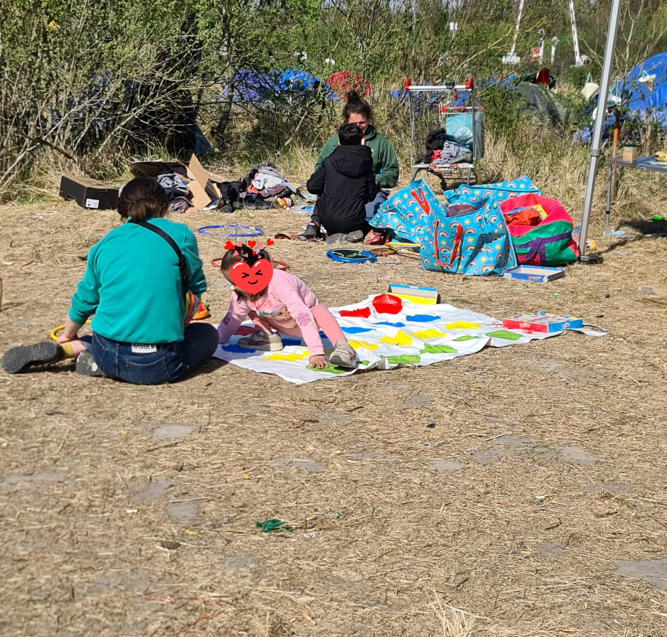
Key words to know
Refugee: a person who has been forced to leave their country in order to escape war, persecution, or natural disaster.
Persecution: hostility and ill-treatment, especially because of race or political or religious beliefs; oppression.
Oxford Dictionary
Refugees, including young children, at a camp in Northern France.
How would you feel if you were forced to leave your country?

Slide 4
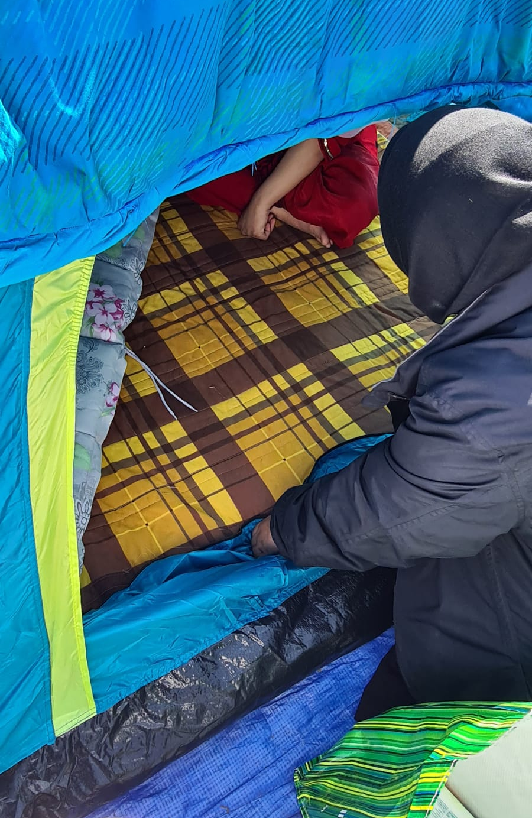
How might someone become a refugee?
No one wants to become a refugee, they’ve had to.
Refugees have to leave their country for different reasons, including: war or violence, natural disasters, hunger or extreme poverty, and their beliefs.
Often refugees will have more than one reason to have to leave their country. It is never an easy decision.
A refugee family being helped by volunteers. What are they living in?

Slide 5
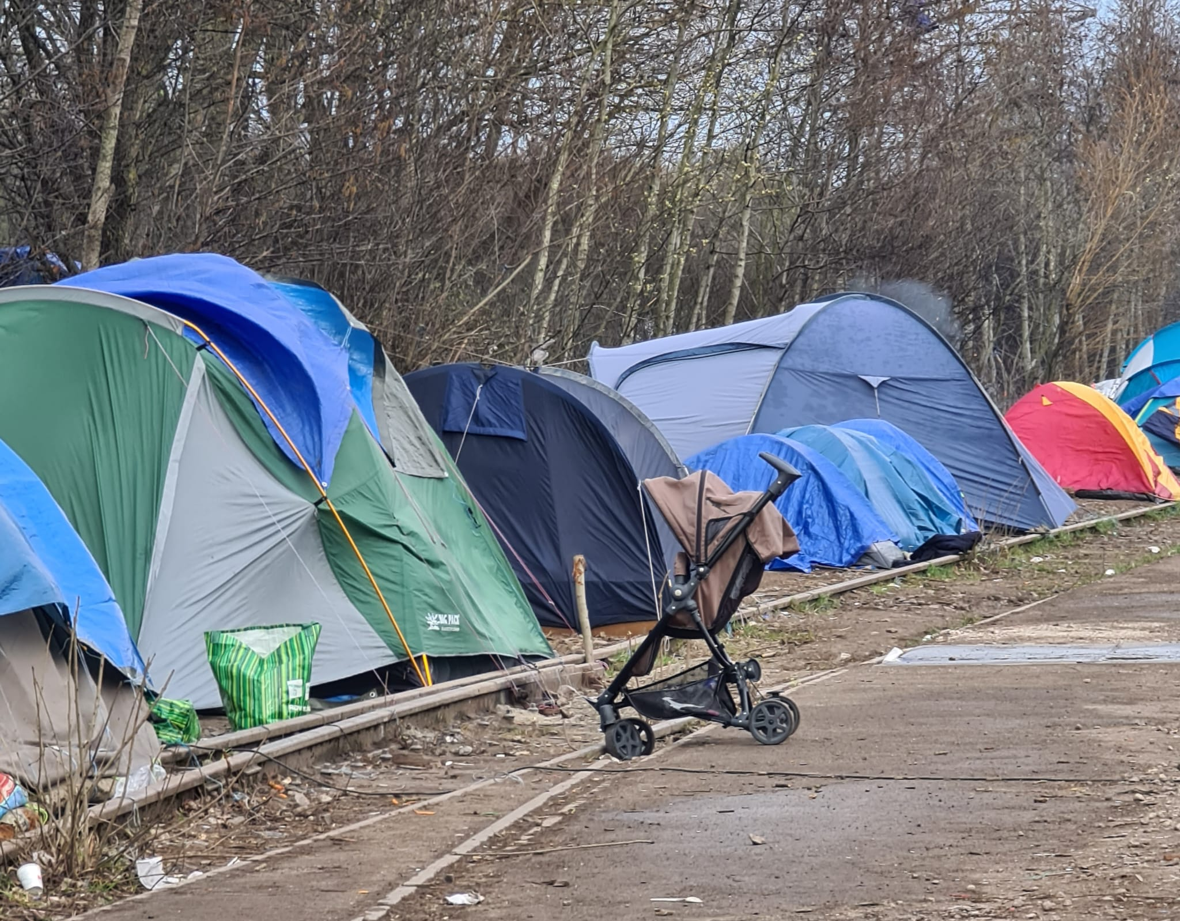
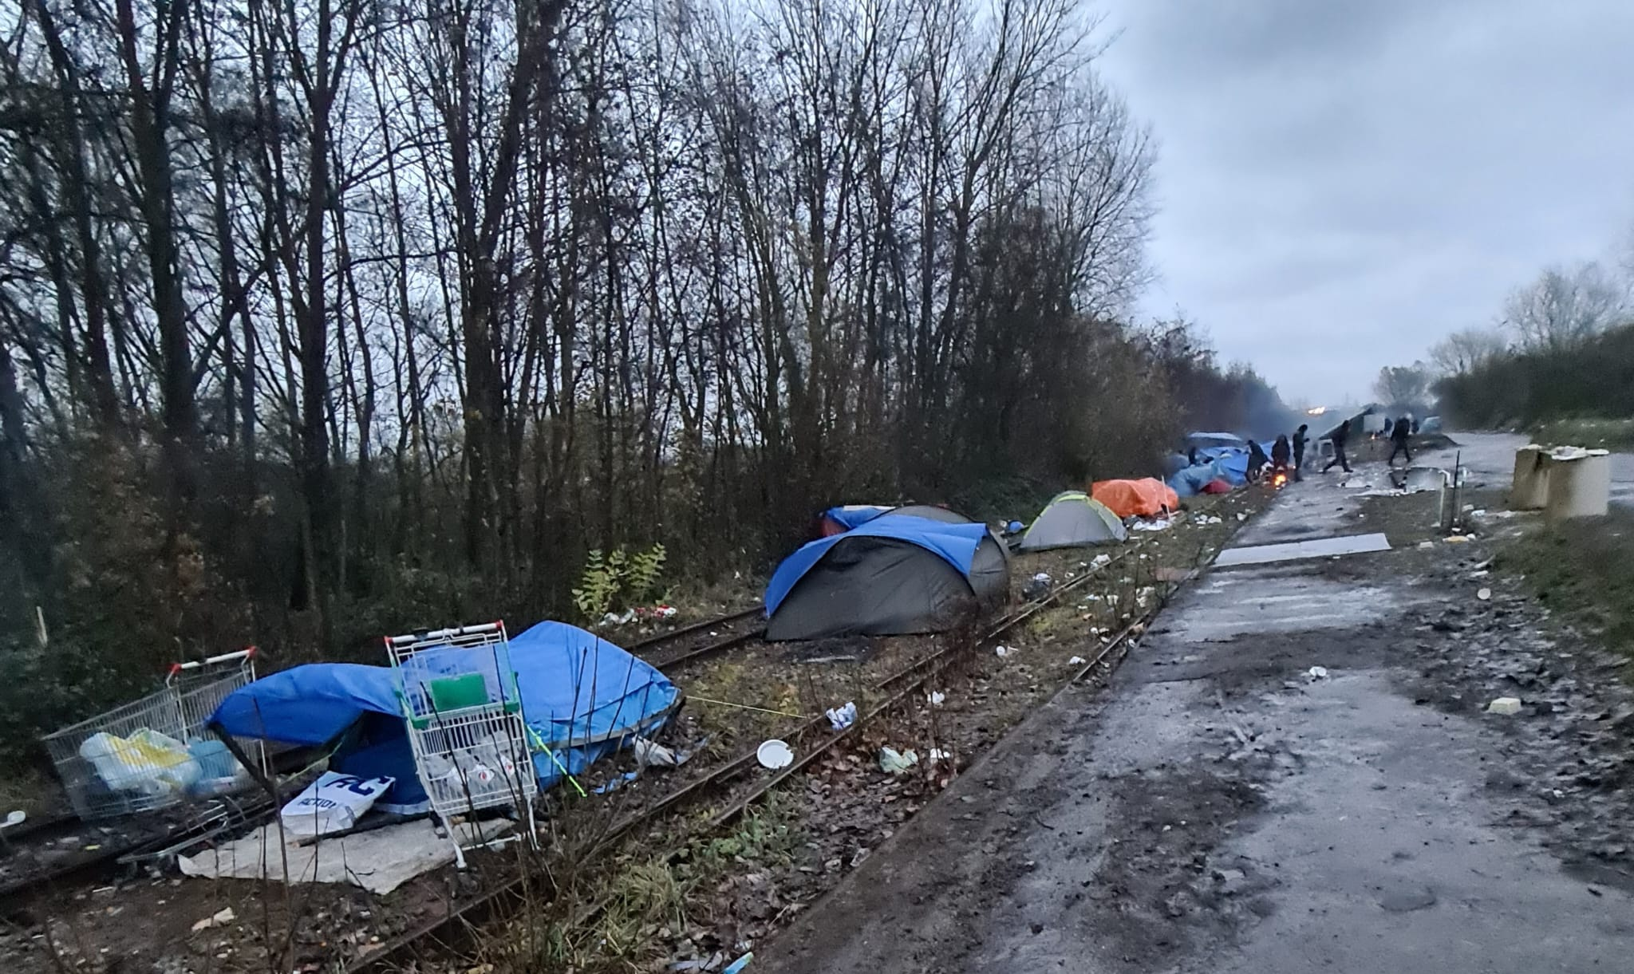
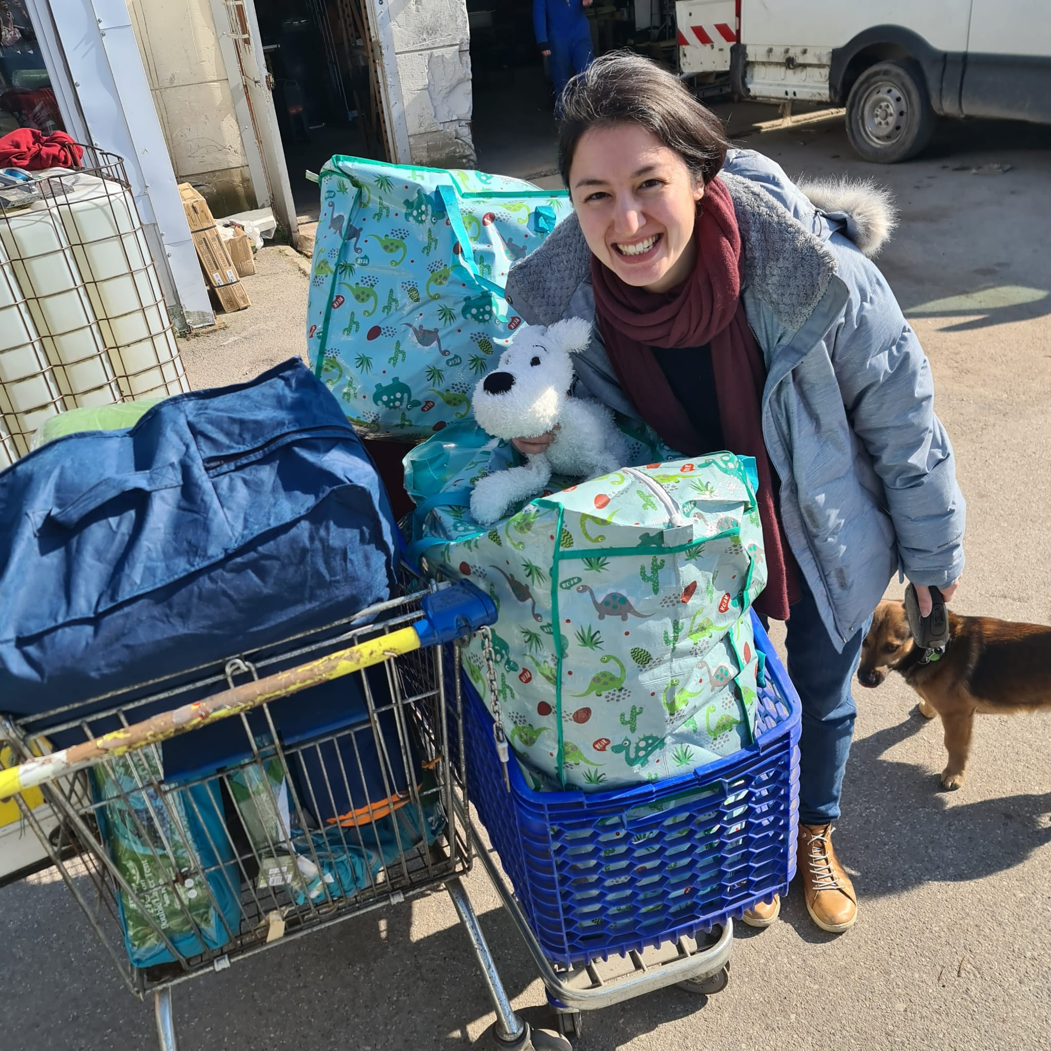
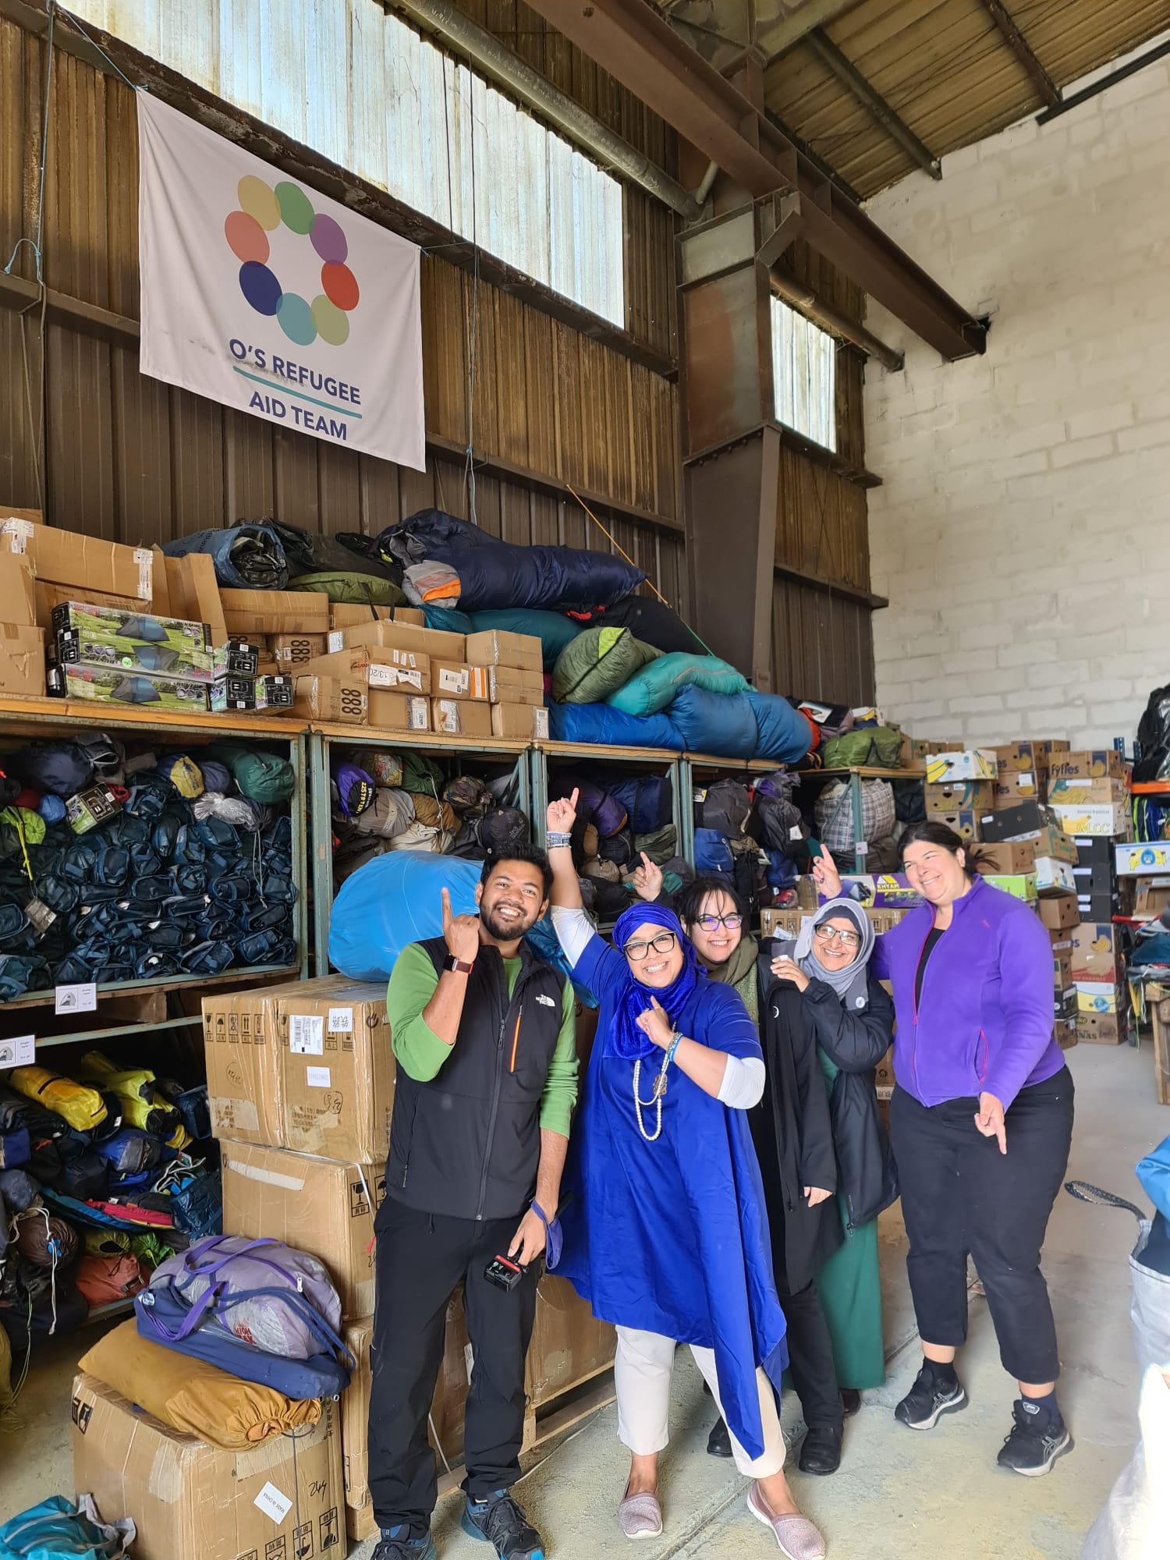
What are refugee camps?
Until refugees find a safe place to live they often have to stay in refugee camps.
Refugee camps are temporary facilities built to provide immediate protection and assistance to people who have been forced to flee their homes due to war, persecution or violence.
Sometimes they may stay a few months but often it can be many months if not years.
Living conditions can be difficult and refugees often need support.
In Northern France, O’s Refugee Aid Team help refugees at the nearby camps who are forced to live in poor conditions.

Slide 6
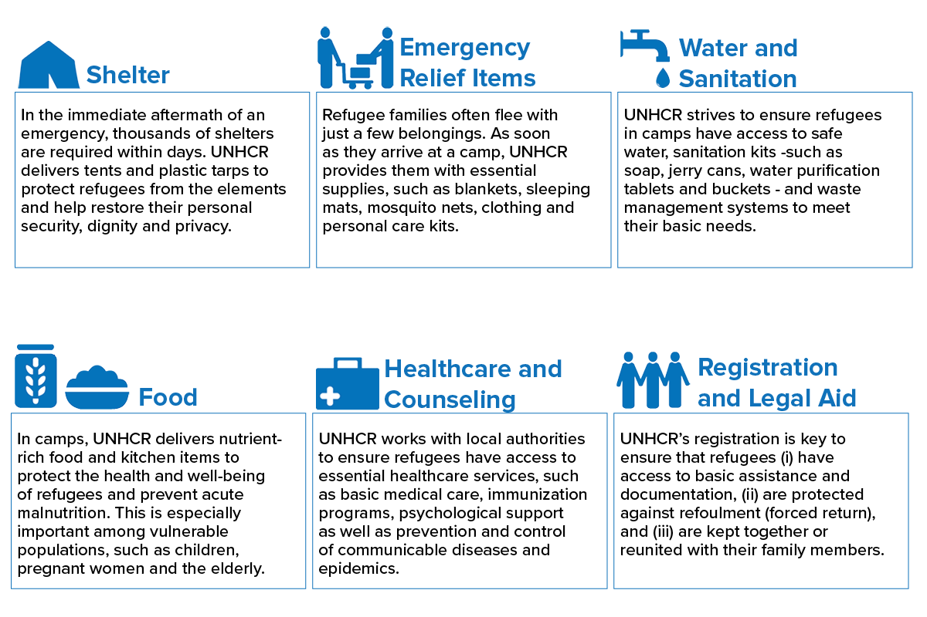
What services are provided?
https://www.unrefugees.org/refugee-facts/camps/

Slide 7
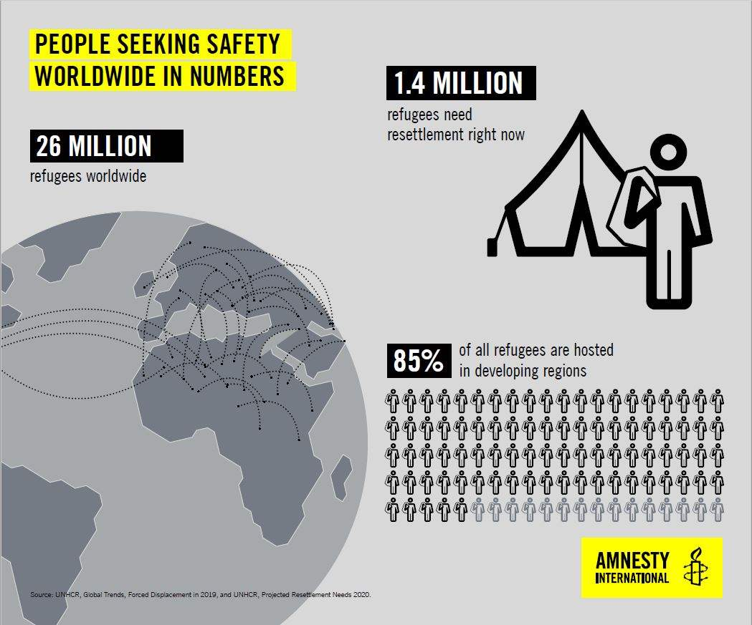
How many people need help right now?
Refugees don’t all come from the same place. Remember there are many reasons why someone might become a refugee.
In 2019, most refugees come from Syria, Venezuela, Afghanistan, South Sudan and Myanmar.
More recently, Ukraine.

Slide 8
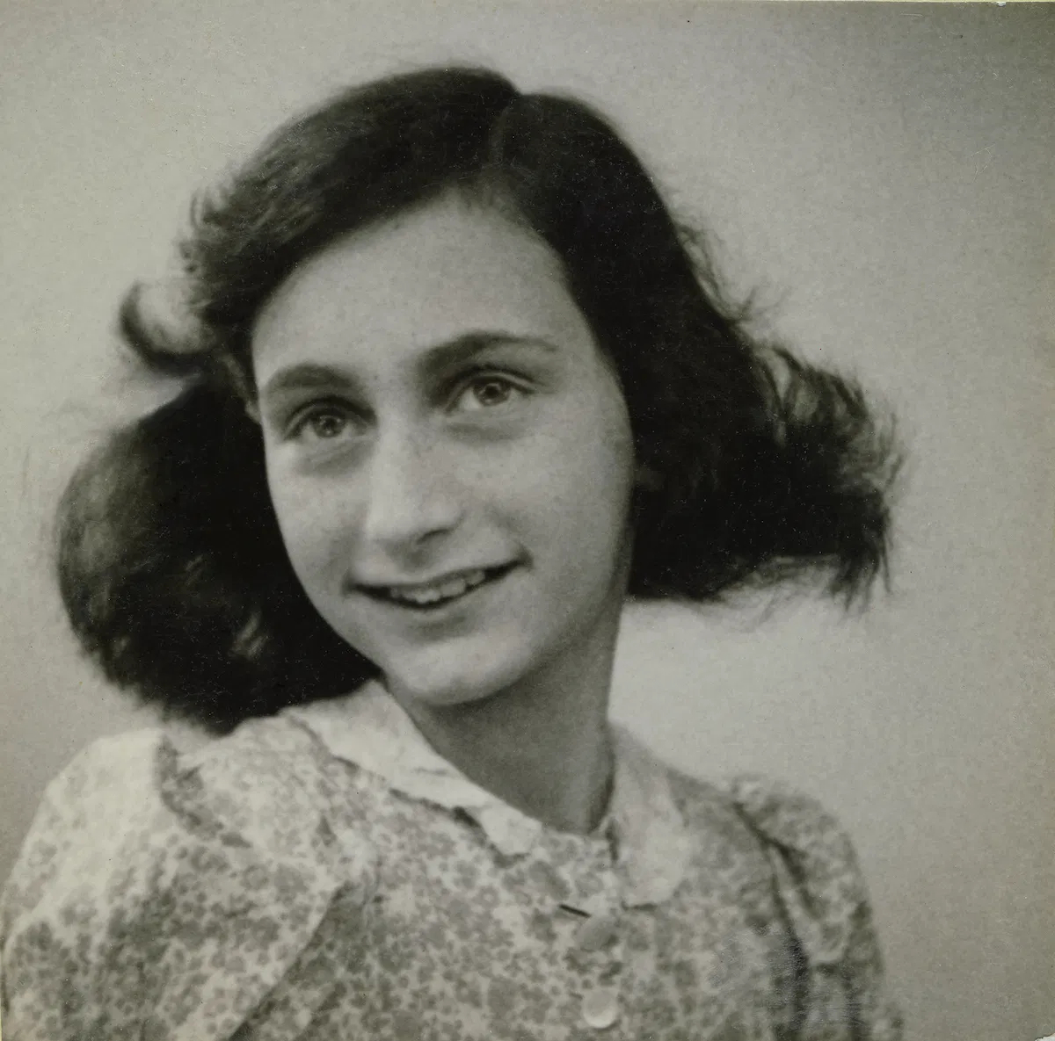
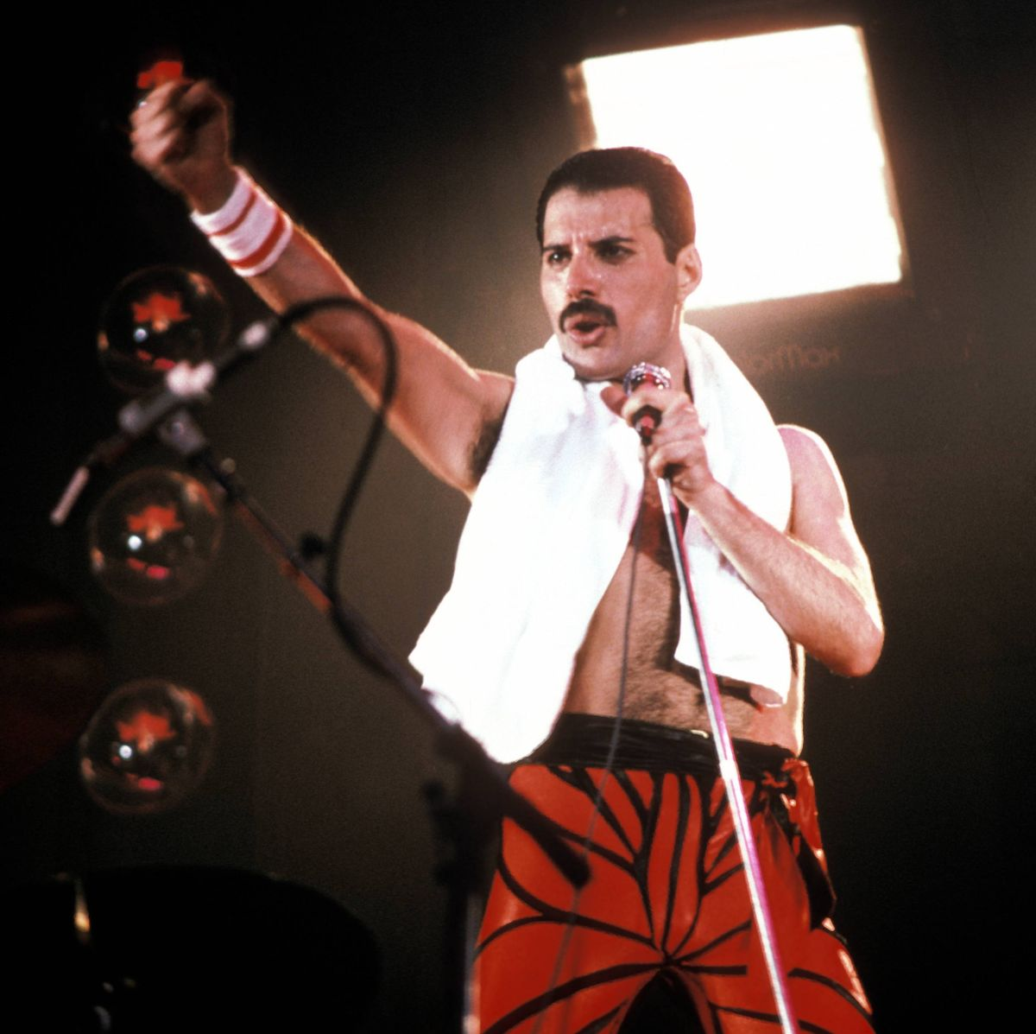
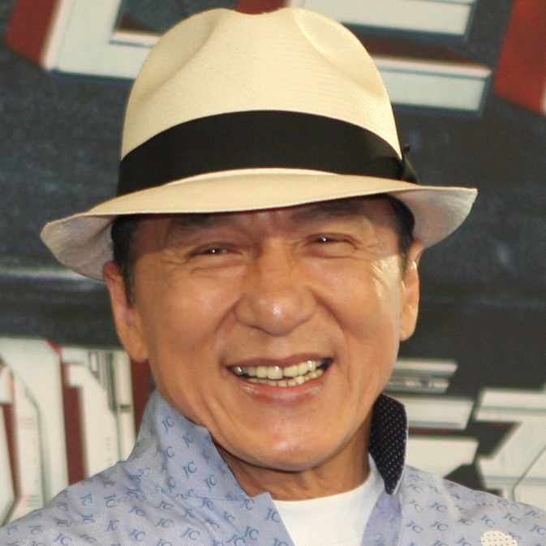
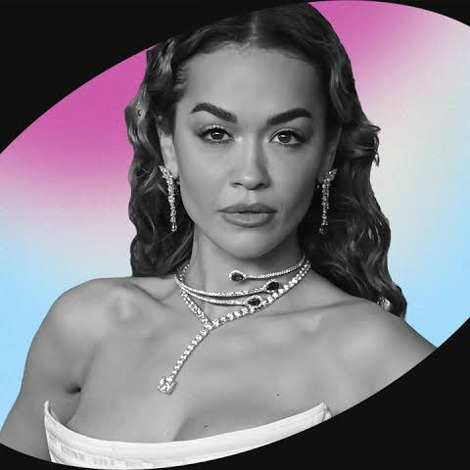
Who are these individuals and what do they have in common?

Slide 9
Anne Frank – Diarist
Who are these individuals and what do they have in common?
They were all refugees…
Freddie Mercury - Singer
Jackie Chan - Actor
Jesus – Religious
Her family were among the 300,000 Jews who fled Germany between 1933 and 1939.
Rita Ora - Singer
Lead singer of the band Queen, fled to England from Zanzibar in 1964.
Fled to the US from Hong Kong after being threatened with death by the Triads.
His family fled from the holy land because of King Herod.
Came to the UK as a refugee from Kosovo as baby.

Slide 10
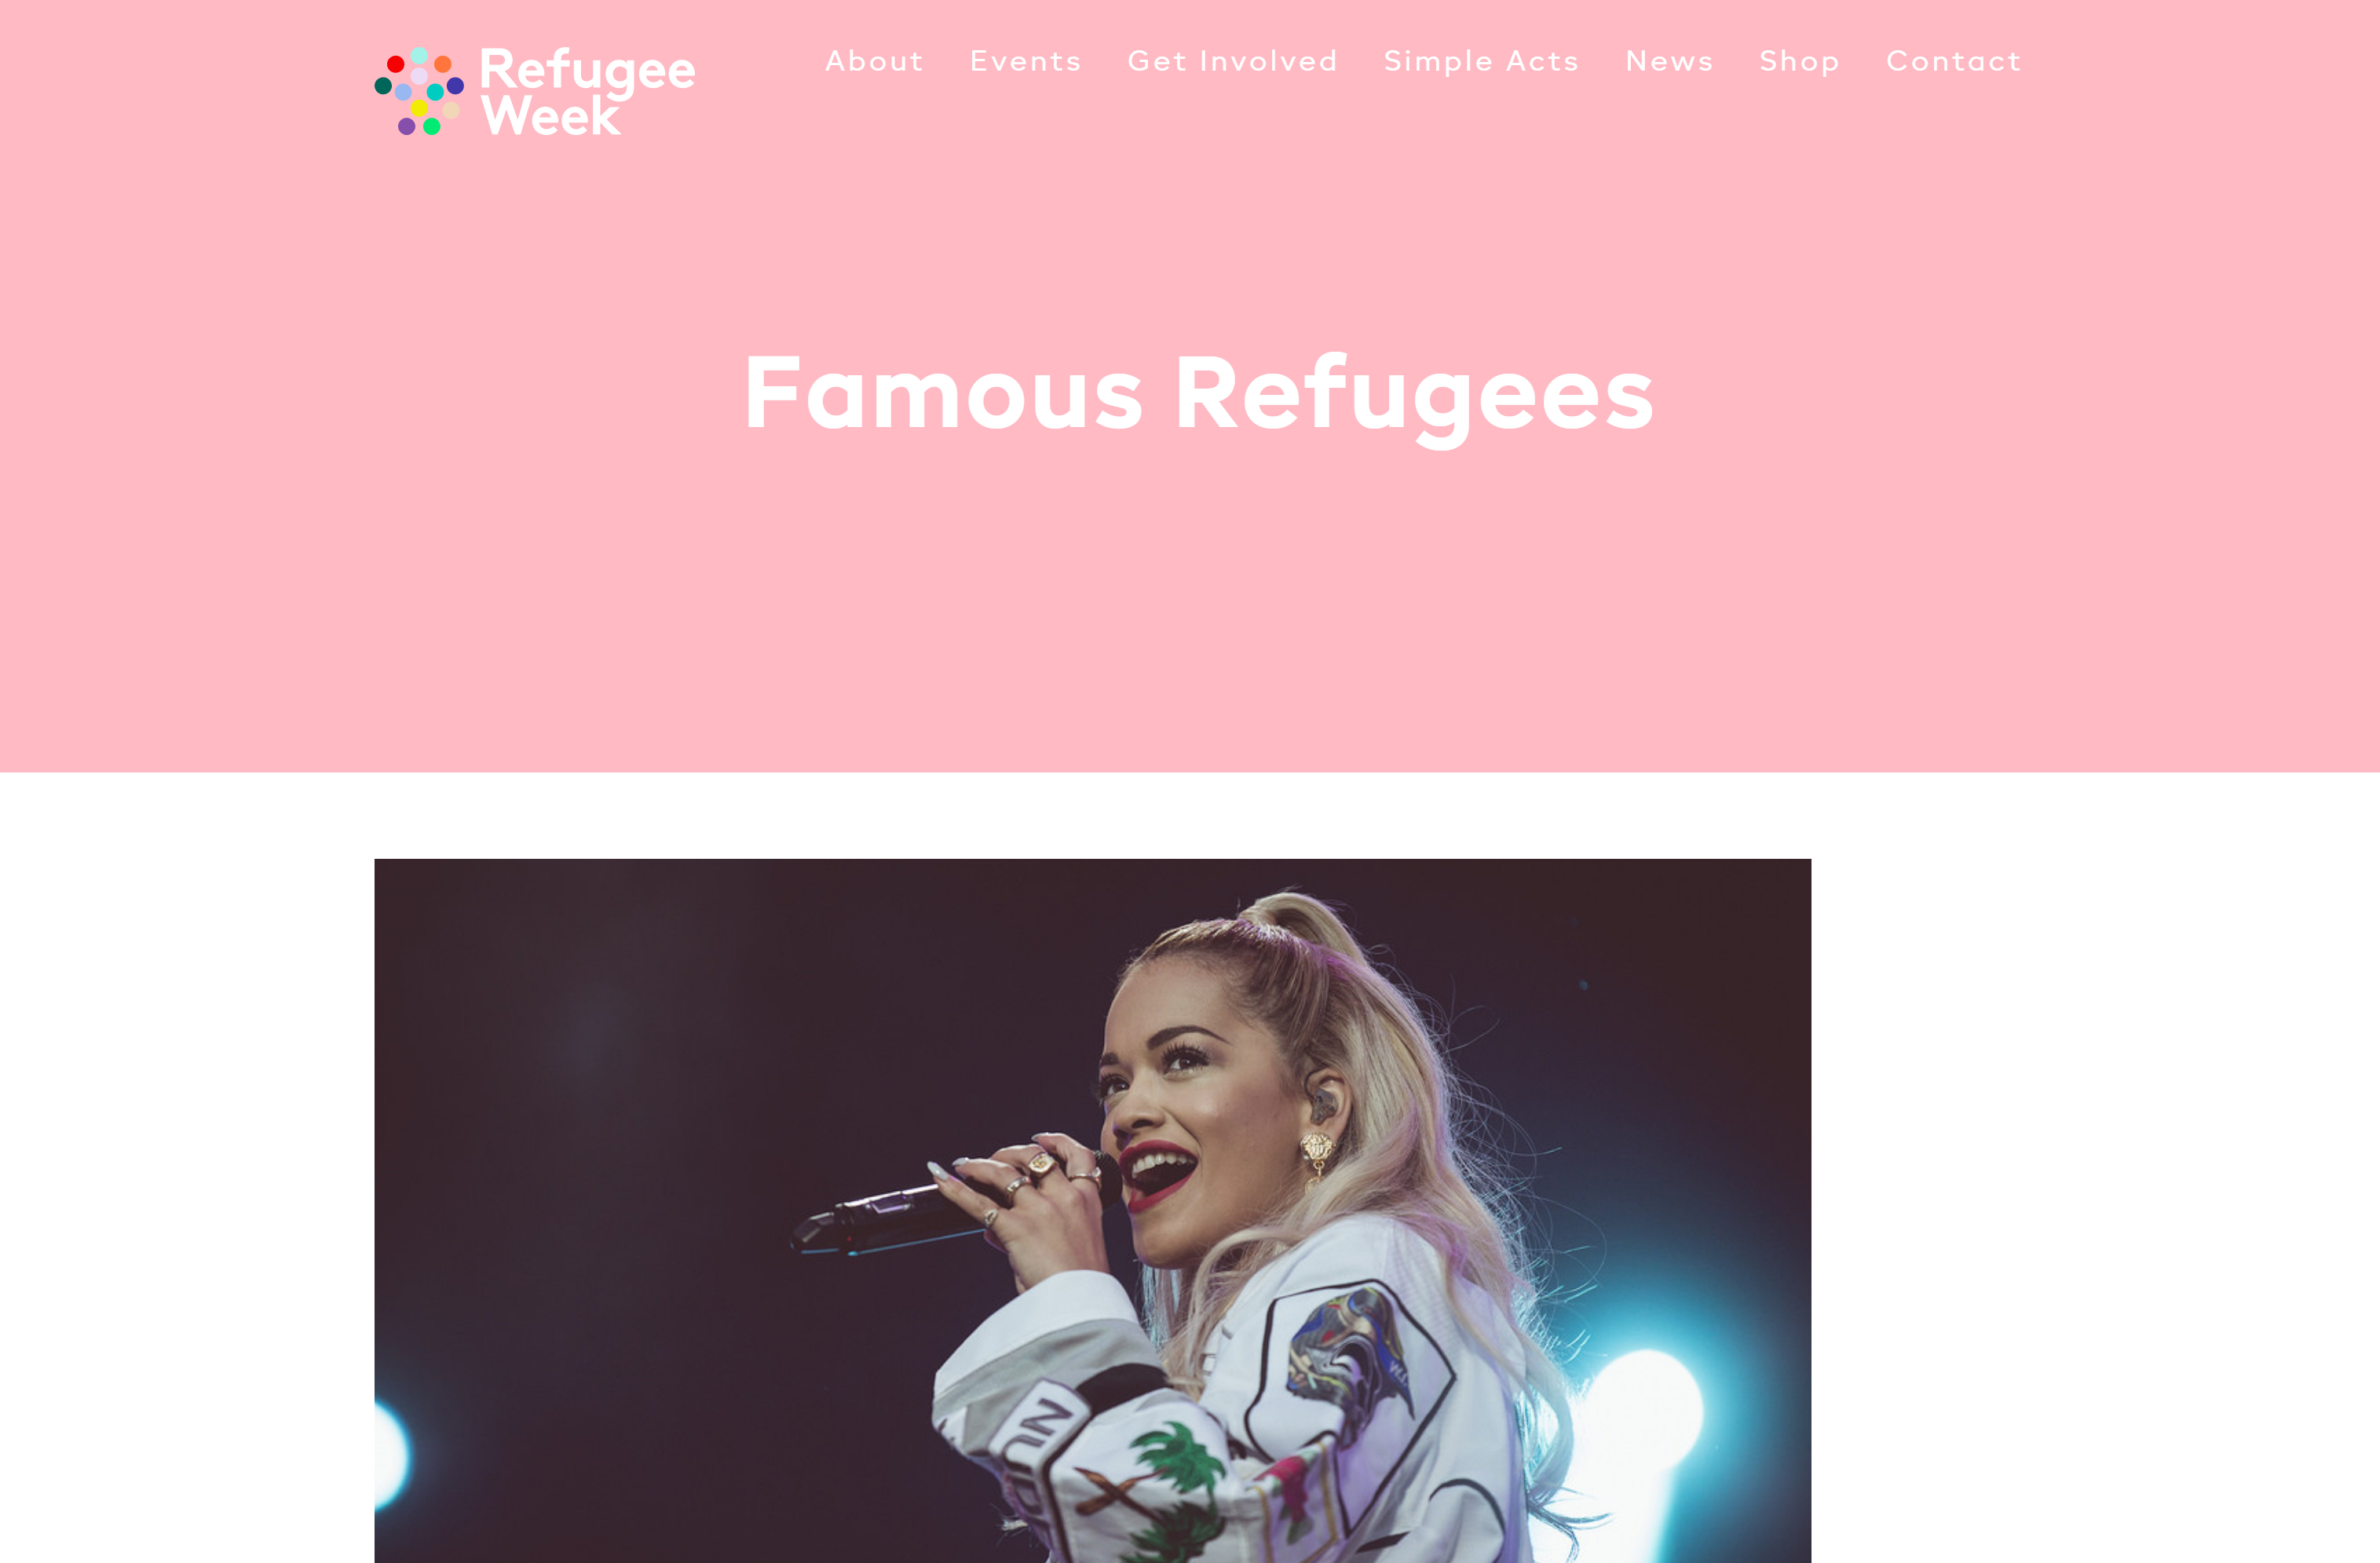
Who else was a refugee?
The official Refugee Week website has a detailed list of lots of famous refugees.
Who do you recognise from the list?
Where did they come from?
Why did they have to leave?
Click here to discover more

Slide 11
Who is helping refugees?
There are many organisations doing wonderful work to support refugees. Lets take a look at a few of them.

Slide 12
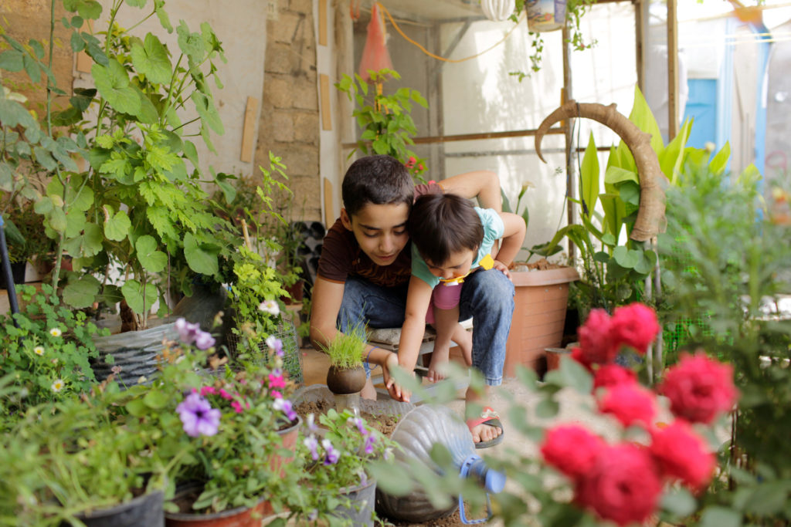
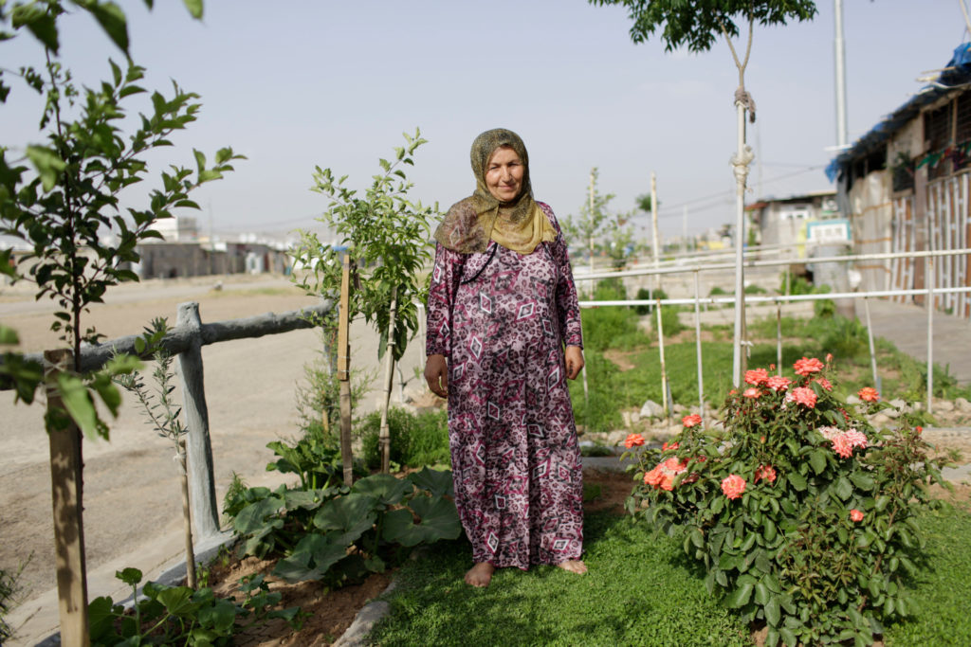
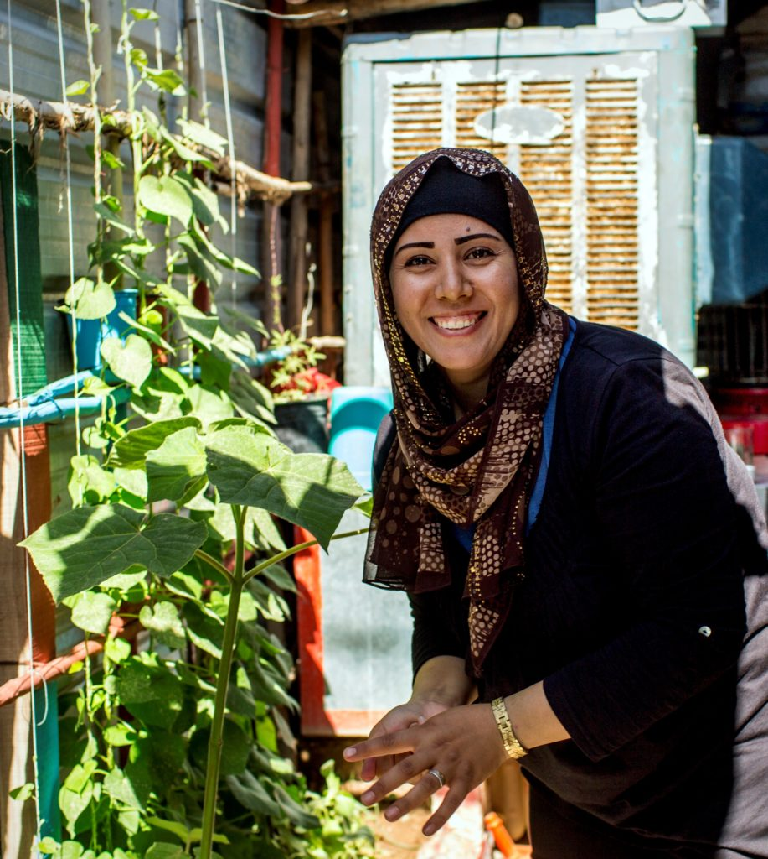
Lemon Tree Trust
You may have purchased a VIP Book Box and spotted some Lemon Tree Trust goodies inside.
Since 2015, the Lemon Tree Trust has supported refugees and communities of forced migrants, to create home and community gardens, garden competitions and education projects.
Watch a short video about the Lemon Tree Trust here.

Slide 13
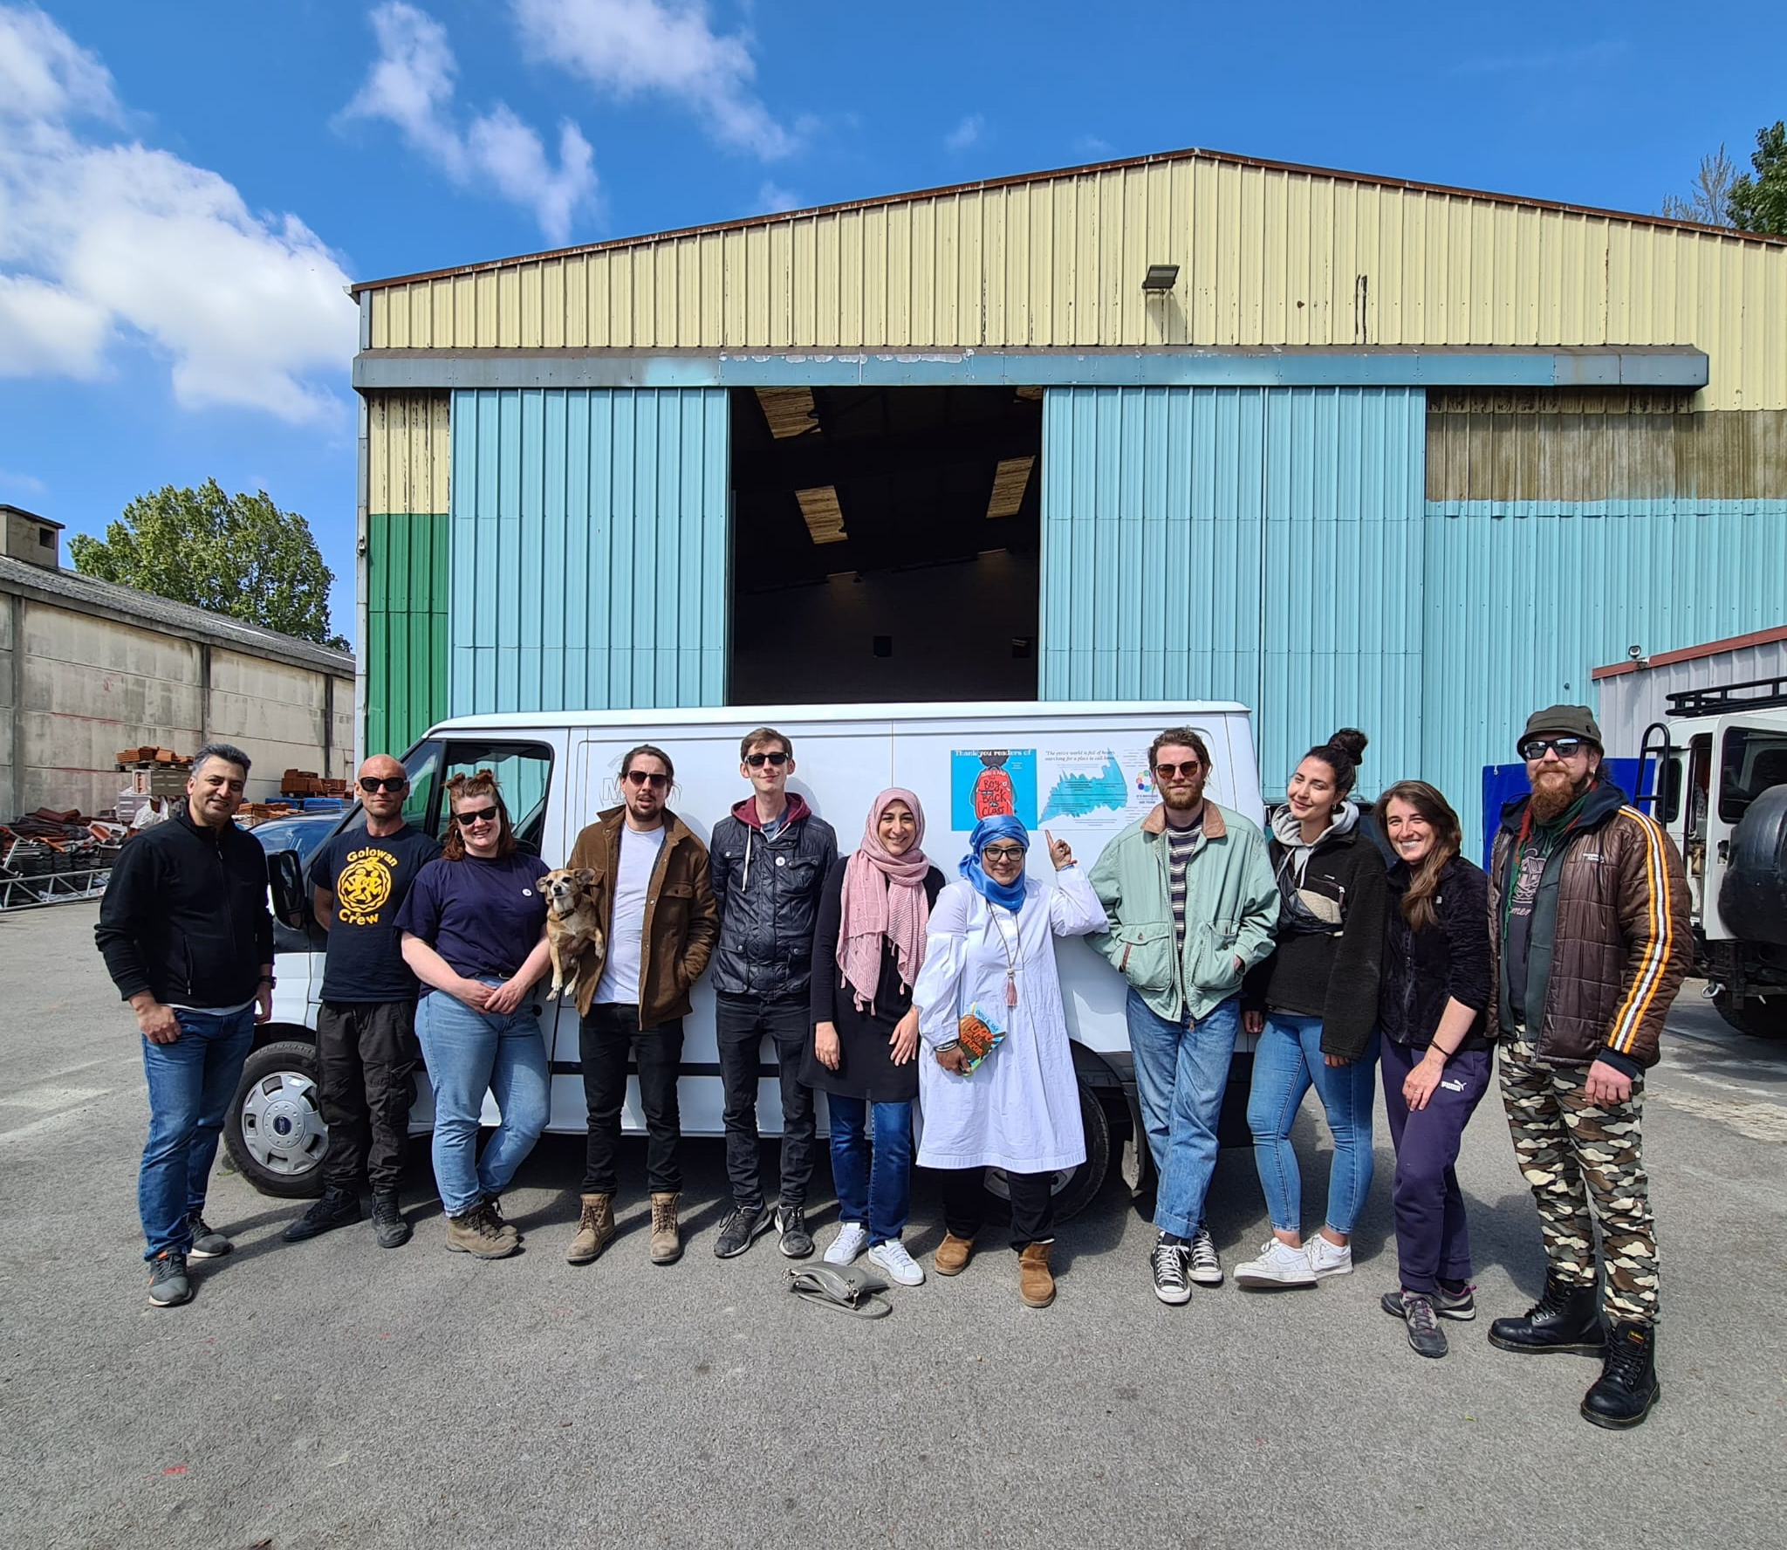
O’s Refugee Aid Team
Most of the pictures of refugees featured in this Powerpoint, have been taken by the author, Onjali Rauf, who also runs the organization, ‘O’s Refugee Aid Team’.
They raise awareness of the refugee crisis as well as much needed funds.
Find out more here:
www.osrefugeeaidteam.org

Slide 14
How can we help refugees?
Just by taking part in Refugee Week, you’re already a superstar!
Help us to Spread Hope by talking to others and taking part in events and activities this week.
If you want to go the extra mile, why not see if you can help us to raise money for O’s Refugee Aid Team. Money can be donated here: osrefugeeaidteam.org/donate/
50% of the profits from the refugee products in the VIP Reading shop goes to O’s Refugee Aid Team!

Slide 15
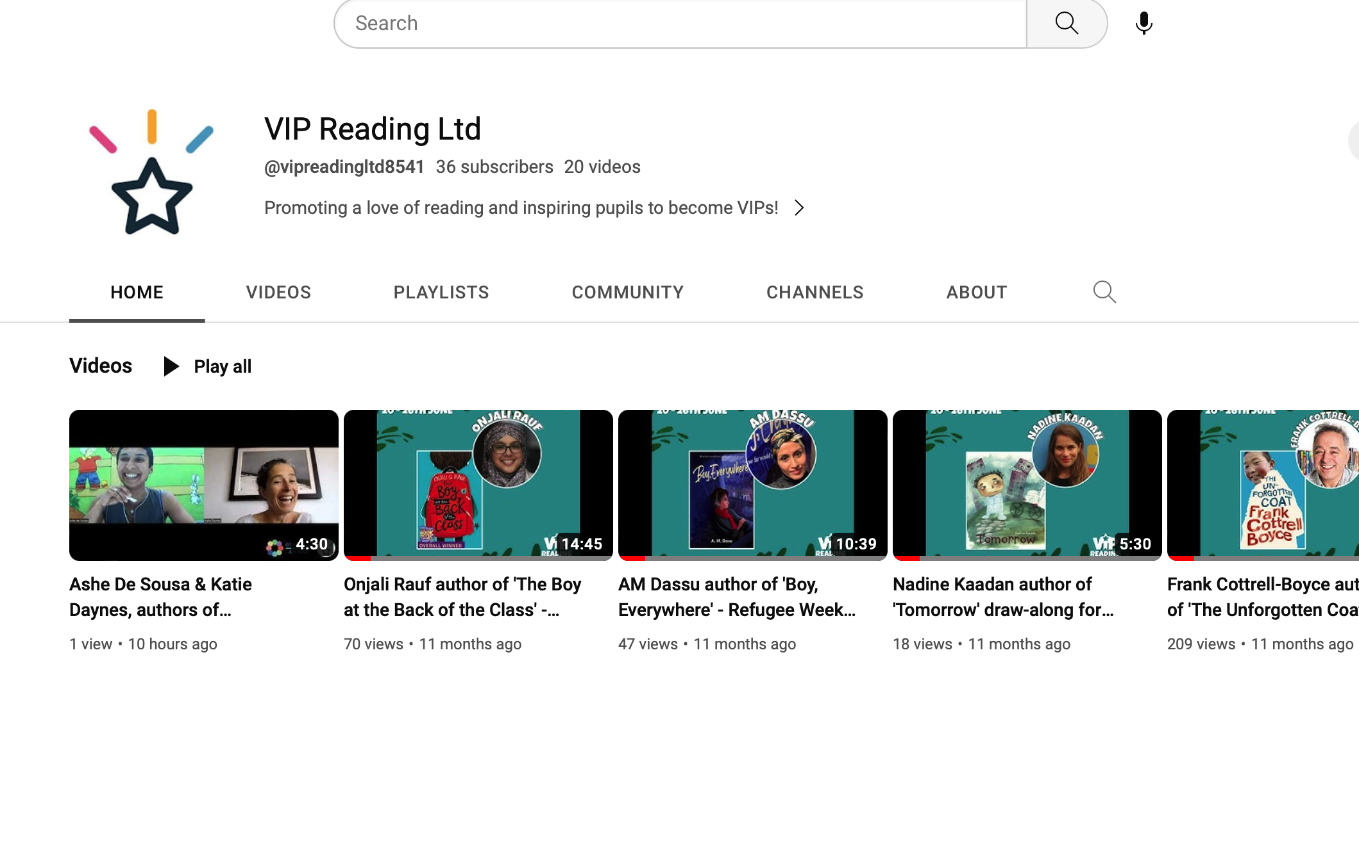
More activities on the VIP website…
Exclusive author videos on our YouTube channel!

